Slide 1


Chapter 6
Wireless and Mobile Networks
Computer Networking: A Top Down Approach
6th edition
Jim Kurose, Keith Ross
Addison-Wesley
March 2012
A note on the use of these ppt slides:
We’re making these slides freely available to all (faculty, students, readers). They’re in PowerPoint form so you see the animations; and can add, modify, and delete slides (including this one) and slide content to suit your needs. They obviously represent a lot of work on our part. In return for use, we only ask the following:
If you use these slides (e.g., in a class) that you mention their source (after all, we’d like people to use our book!)
If you post any slides on a www site, that you note that they are adapted from (or perhaps identical to) our slides, and note our copyright of this material.
Thanks and enjoy! JFK/KWR
NOTE:EDITED VERSION (UMinho, 2016)
All material copyright 1996-2012
J.F Kurose and K.W. Ross, All Rights Reserved
Wireless, Mobile Networks
6-<number>

Slide 2
Ch. 6: Wireless and Mobile Networks
Background:
# wireless (mobile) phone subscribers now exceeds # wired phone subscribers (5-to-1)!
# wireless Internet-connected devices equals # wireline Internet-connected devices
  laptops, Internet-enabled phones promise anytime untethered Internet access
two important (but different) challenges
  wireless: communication over wireless link
  mobility: handling the mobile user who changes point of attachment to network
Wireless, Mobile Networks
6-<number>

Slide 3
Chapter 6 outline
6.1 Introduction
Wireless
6.2 Wireless links, characteristics
  CDMA
6.3 IEEE 802.11 wireless LANs (“Wi-Fi”)
6.4 Cellular Internet Access
  architecture
  standards (e.g., GSM)
Mobility
6.5 Principles: addressing and routing to mobile users
6.6 Mobile IP
6.7 Handling mobility in cellular networks
6.8 Mobility and higher-layer protocols
6.9 Summary
Wireless, Mobile Networks
6-<number>

Slide 4



















Elements of a wireless network
network
infrastructure
Wireless, Mobile Networks
6-<number>

Slide 5



Elements of a wireless network
wireless hosts
laptop, smartphone
run applications
may be stationary (non-mobile) or mobile
  wireless does not always mean mobility
network
infrastructure
Wireless, Mobile Networks
6-<number>

Slide 6

Elements of a wireless network
base station
typically connected to wired network
relay - responsible for sending packets between wired network and wireless host(s) in its “area”
  e.g., cell towers, 802.11 access points
network
infrastructure
Wireless, Mobile Networks
6-<number>

Slide 7
Elements of a wireless network
wireless link
typically used to connect mobile(s) to base station
also used as backbone link
multiple access protocol coordinates link access
various data rates, transmission distance
network
infrastructure
Wireless, Mobile Networks
6-<number>

Slide 8
Characteristics of selected wireless links
200
802.11n
54
802.11a,g
802.11a,g point-to-point
5-11
802.11b
4G: LTWE WIMAX
4
3G: UMTS/WCDMA-HSPDA, CDMA2000-1xEVDO
Data rate (Mbps)
1
802.15
.384
2.5G: UMTS/WCDMA, CDMA2000
.056
2G: IS-95, CDMA, GSM
Indoor
10-30m
Outdoor
50-200m
Mid-range
outdoor
200m – 4 Km
Long-range
outdoor
5Km – 20 Km
Wireless, Mobile Networks
6-<number>

Slide 9
Elements of a wireless network
infrastructure mode
base station connects mobiles into wired network
handoff: mobile changes base station providing connection into wired network
network
infrastructure
Wireless, Mobile Networks
6-<number>

Slide 10


Elements of a wireless network
ad hoc mode
no base stations
nodes can only transmit to other nodes within link coverage
nodes organize themselves into a network: route among themselves
Wireless, Mobile Networks
6-<number>

Slide 11
Wireless network taxonomy
single hop
multiple hops
host connects to
base station (WiFi,
WiMAX, cellular)
which connects to
larger Internet
host may have to
relay through several
wireless nodes to
connect to larger
Internet: mesh net
infrastructure
(e.g., APs)
no base station, no
connection to larger
Internet. May have to
relay to reach other
a given wireless node
MANET, VANET
no
infrastructure
no base station, no
connection to larger
Internet (Bluetooth,
ad hoc nets)
Wireless, Mobile Networks
6-<number>

Slide 12
Wireless Link Characteristics (1)
important differences from wired link ….
  decreased signal strength: radio signal attenuates as it propagates through matter (path loss)
  interference from other sources: standardized wireless network frequencies (e.g., 2.4 GHz) shared by other devices (e.g., phone); devices (motors) interfere as well
  multipath propagation: radio signal reflects off objects ground, arriving at destination at slightly different times
…. make communication across (even a point to point) wireless link much more “difficult”
Wireless, Mobile Networks
6-<number>

Slide 13
Wireless Link Characteristics (2)
SNR: signal-to-noise ratio
  larger SNR – easier to extract signal from noise (a “good thing”)
SNR versus BER tradeoffs
  given physical layer: increase power -> increase SNR->decrease BER
  given SNR: choose physical layer that meets BER requirement, giving highest throughput
    SNR may change with mobility: dynamically adapt physical layer (modulation technique, rate)
10⁻¹
10⁻²
10⁻³
BER
10⁻⁴
10⁻⁵
10⁻⁶
10⁻⁷
10
20
30
40
SNR(dB)
QAM256 (8 Mbps)
QAM16 (4 Mbps)
BPSK (1 Mbps)
Wireless, Mobile Networks
6-<number>

Slide 14

Wireless network characteristics
Multiple wireless senders and receivers create additional problems (beyond multiple access):
A
B
C
C
A’s signal
strength
C’s signal
strength
B
A
Hidden terminal problem
B, A hear each other
B, C hear each other
A, C can not hear each other means A, C unaware of their interference at B
space
Signal attenuation:
B, A hear each other
B, C hear each other
A, C cannot hear each other interfering at B
Wireless, Mobile Networks
6-<number>

Slide 15
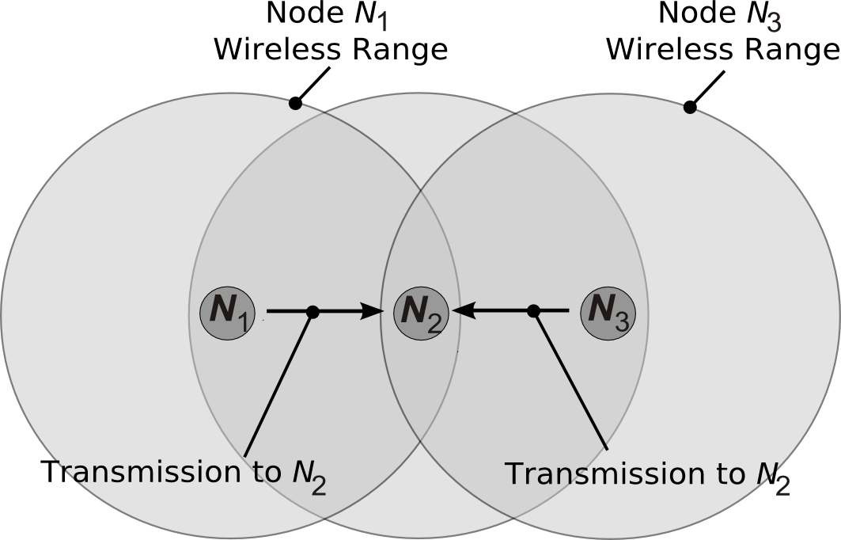
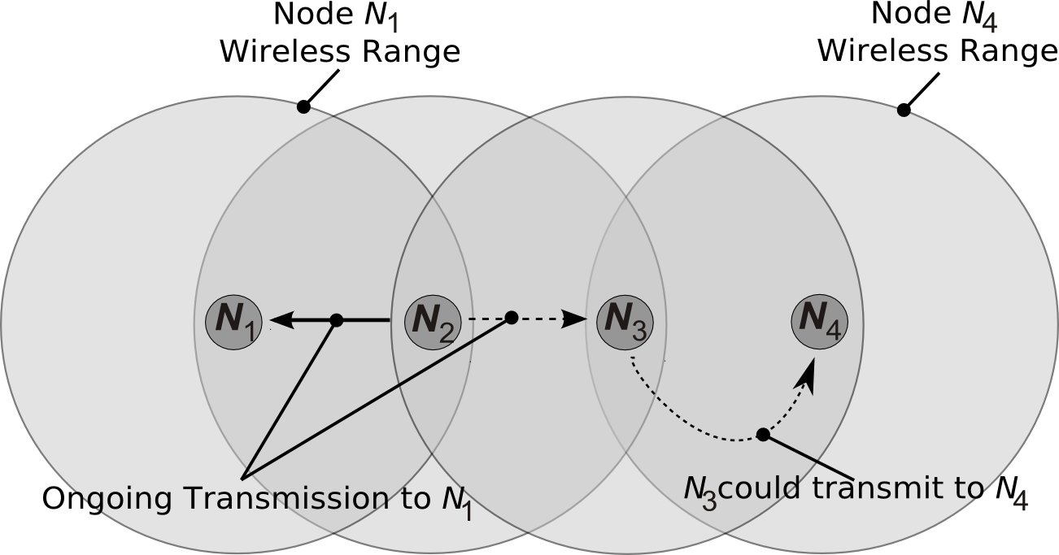
Wireless network characteristics
Escutar o canal no transmissor não fornece informação acerca do canal no receptor
Hidden node problem
Exposed node problem
N1 e N3 não se escutam mutuamente devido a obstáculos ou atenuação: os seus pacotes colidem em N2
N1 e N4 poderiam ser receptores simultâneos mas os respectivos emissores N2 e N3 estão em zona de alcance
Problema menos grave que o anterior
reduz a utilização
menos estudado
Dois principais problemas
Wireless, Mobile Networks
6-<number>

Slide 16
Chapter 6 outline
6.1 Introduction
Wireless
6.2 Wireless links, characteristics
  CDMA
6.3 IEEE 802.11 wireless LANs (“Wi-Fi”)
6.4 Cellular Internet Access
  architecture
  standards (e.g., GSM)
Mobility
6.5 Principles: addressing and routing to mobile users
6.6 Mobile IP
6.7 Handling mobility in cellular networks
6.8 Mobility and higher-layer protocols
6.9 Summary
Wireless, Mobile Networks
6-<number>

Slide 17
IEEE 802.11 Wireless LAN
802.11b
2.4-5 GHz unlicensed spectrum
up to 11 Mbps
direct sequence spread spectrum (DSSS) in physical layer
802.11a
  5-6 GHz range
  up to 54 Mbps
802.11g
  2.4-5 GHz range
  up to 54 Mbps
802.11n: multiple antennae
  2.4-5 GHz range
  up to 600 Mbps
802.11ac
5 GHz unlicensed spectrum
up to 1.3Gbps
all use CSMA/CA for multiple access
all have base-station and ad-hoc network versions
Wireless, Mobile Networks
6-<number>

Slide 18
IEEE 802.11 Wireless LAN
Protocolo | Data Norma | Frequência | Débito Máximo | Técnica de Modulação | Distância (int - ext)
802.11 | Versão inicial de 1997 de baixo débito (1 ou 2Mbps)
802.11a | 1999 | 5 GHz | 54 Mbps | OFDM | ~35-120m
802.11b | 1999 | 2,4 GHz | 11 Mbps | DSSS | ~38-140m
802.11g | 2003 | 2,4 GHz | 54 Mbps | OFDM | ~38-140m
802.11n | 2009 | 2,4-5 GHz | até 600 Mbps | MIMO-OFDM | ~70-250m
802.11ac | 2013 | 5GHz | até 1.3Gbps | Multi-user MIMO | ~35m
802.11e | similar a 802.11b com suporte de Qualidade de Serviço
Wireless, Mobile Networks
6-<number>

Slide 19




802.11 LAN architecture
wireless host communicates with base station
  base station = access point (AP)
Basic Service Set (BSS) (aka “cell”) in infrastructure mode contains:
  wireless hosts
  access point (AP): base station
  ad hoc mode: hosts only
Internet
hub, switch
or router
BSS 1
BSS 2
Wireless, Mobile Networks
6-<number>

Slide 20
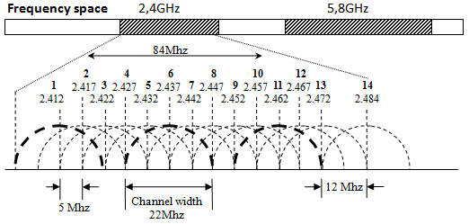
802.11: channels
802.11g: 2.4GHz-2.485GHz spectrum divided into 14 channels at different frequencies (depends on continent / country)
  AP admin chooses frequency for AP
  interference possible: channel can be same as that chosen by neighboring AP!
  1, 6 and 11 non-overlapping channels
Wireless, Mobile Networks
6-<number>

Slide 21
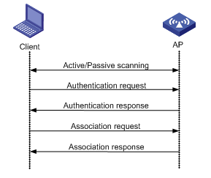
802.11: association
host: must associate with an AP
  scans channels, listening for beacon frames containing AP’s name (SSID) and MAC address
  selects AP to associate with
  may perform authentication
  will typically run DHCP to get IP address in AP’s subnet
Wireless, Mobile Networks
6-<number>

Slide 22
802.11: passive/active scanning
BBS 1
BBS 2
BBS 1
BBS 2
1
AP 2
AP 1
1
1
AP 2
AP 1
2
2
2
3
3
4
H1
H1
passive scanning:
beacon frames sent from APs
association Request frame sent: H1 to selected AP
association Response frame sent from selected AP to H1
active scanning:
Probe Request frame broadcast from H1
Probe Response frames sent from APs
Association Request frame sent: H1 to selected AP
Association Response frame sent from selected AP to H1
Wireless, Mobile Networks
6-<number>

Slide 23
IEEE 802.11: multiple access
IEEE 802.11 standard for WLANs defines a Distributed Control Function (DCF) for sharing access to the medium based on the CSMA/CA protocol.
DCF is the basic access mode
DCF has an option for virtual channel reservation (RTS/CTS... studied later on)
Wireless, Mobile Networks
6-<number>

Slide 24




IEEE 802.11: multiple access
avoid collisions: 2⁺ nodes transmitting at same time
802.11: CSMA - sense before transmitting
  don’t collide with ongoing transmission by other node
802.11: no collision detection!
  difficult to receive (sense collisions) when transmitting due to weak received signals (fading)
  can’t sense all collisions in any case: hidden terminal, fading
  goal: avoid collisions: CSMA/C(ollision)A(voidance)
A
B
C
C
B
A’s signal
strength
C’s signal
strength
A
space
Wireless, Mobile Networks
6-<number>

Slide 25
IEEE 802.11 MAC Protocol: CSMA/CA
802.11 sender
1 if sense channel idle for DIFS then
  transmit entire frame (no CD)
2 if sense channel busy then
  start random backoff time
  timer counts down while channel idle
  transmit when timer expires
  if no ACK, increase random backoff interval, repeat 2
802.11 receiver
- if frame received OK
return ACK after SIFS (ACK needed due to hidden terminal problem)
sender
receiver
DIFS
data
SIFS
ACK
Wireless, Mobile Networks
6-<number>

Slide 26
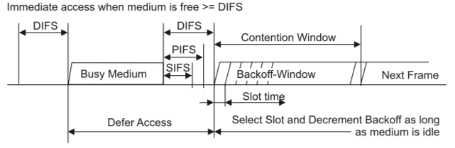
IEEE 802.11 MAC Protocol: CSMA/CA
The time interval between frames is called Interframe Space (IFS)
Time intervals are independent of STA bit rate, depend on PHY layer
  SIFS – Short Interframe Space (e.g. before sending a ACK or CTS frame)
  DIFS – Distributed Interframe Space (DCF mode, e.g. for data and mngt frames)
  PIFS – Point Interframe Space (PCF mode, not studied here)
DIFS > SIFS prevents other STAs to attempt to use the medium, allowing the completion of the frame exchange in progress.
A time slot is the time needed to detect transmission from other STA
Wireless, Mobile Networks
6-<number>

Slide 27
IEEE 802.11 MAC Protocol: CSMA/CA
If the medium is busy the node defers its transmission until the end of the current transmission and then it will wait an additional DIFS interval and generate a random backoff delay uniformly chosen in the range [0, W-1] where W is called the backoff window or contention window (CW)
The backoff timer is decreased as long as the medium is sensed to be idle for DIFS, and frozen when a transmission is detected on the medium, and resumed when the channel is detected as idle again for DIFS
When backoff reaches 0, the STA transmits the packet
Wireless, Mobile Networks
6-<number>

Slide 28
Avoiding collisions (more)
idea: allow sender to “reserve” channel rather than random access of data frames: avoid collisions of long data frames
sender first transmits small request-to-send (RTS) packets to BS using CSMA
  RTSs may still collide with each other (but they’re short)
BS broadcasts clear-to-send CTS in response to RTS
CTS heard by all nodes
  sender transmits data frame
  other stations defer transmissions
For small data frames, RTS/CTS may not be used (threshold)
avoid data frame collisions completely
using small reservation packets!
Wireless, Mobile Networks
6-<number>

Slide 29

Collision Avoidance: RTS-CTS exchange
A
B
AP
RTS(B)
RTS(A)
reservation collision
RTS(A)
CTS(A)
CTS(A)
DATA (A)
defer
time
ACK(A)
ACK(A)
Wireless, Mobile Networks
6-<number>

Slide 30
802.11 frame format
2
2
6
6
6
2
6
0 - 2312
4
frame
control
duration
address
1
address
2
address
3
seq
control
address
4
payload
FCS
Address 4: used only in ad hoc mode
Address 1: MAC address
of wireless host or AP
to receive this frame
Address 3: MAC address
of router interface to which AP is attached
Address 2: MAC address
of wireless host or AP
transmitting this frame
Wireless, Mobile Networks
6-<number>

Slide 31
802.11 frame format
octets
2
2
6
6
6
2
6
0 - 2312
4
frame
control
duration
address
1
address
2
address
3
seq
control
address
4
payload
FCS
FCS: Frame Check Sequence used for error control
Specifies several
fc fields
(next)
Sequence Control: consists of two subfields, the Sequence Number (12 bits) and the Fragment Number number (4bits), useful for controlling fragmentation when needed
Duration: Specifies the time duration, in microseconds, required to transmit the pending data or management frame (including, for instance, the time of control frames required plus IFS times).
Important field to inform other stations about total time of tx
Wireless, Mobile Networks
6-<number>

Slide 32
802.11 frame: addressing
Internet
H1
R1
router
R1 MAC addr H1 MAC addr
dest. address
source address
802.3 frame
AP MAC addr H1 MAC addr R1 MAC addr
address 1
address 2
address 3
802.11 frame
Wireless, Mobile Networks
6-<number>

Slide 33
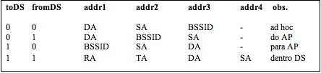
802.11 frame: addressing
The addresses semantics depends on the frame type and directionality
addr1 – MAC address the receiver (varies);
addr2 – MAC address of the sender
Wireless, Mobile Networks
6-<number>

Slide 34
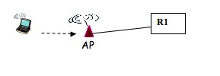

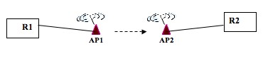
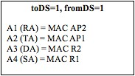


802.11 frame: addressing
DA - Destination Address - receptor final
SA - Source Address - origem da transmissão
RA - Receiver Address - estação wireless que deve processar a trama
wireless STA -> RA=DA
wired node -> RA=MAC AP; DA=router
TA - Transmitter Address - interface wireless que transmitiu a trama
BSSID - MAC da interface wireless do AP (Infrastrurure networks); aleatório BSSID (Ad-hoc networks)
Wireless, Mobile Networks
6-<number>

Slide 35
802.11 frame: more
frame seq #
(for RDT)
duration of reserved
transmission time (RTS/CTS)
2
2
6
6
6
2
6
0 - 2312
4
frame
control
duration
address
1
address
2
address
3
seq
control
address
4
payload
CRC
Power save mode
2
2
4
1
1
1
1
1
1
1
1
Protocol
version
Type
Subtype
To
AP
From
AP
More
frag
Retry
Power
mgt
More
data
WEP
Rsvd
Retry: Indicates a retransmission,
Useful to eliminate duplicates
frame type
(mngt, control, data)
frame subttype
(e.g., Beacon, RTS, CTS, ACK, data)
Wireless, Mobile Networks
6-<number>

Slide 36
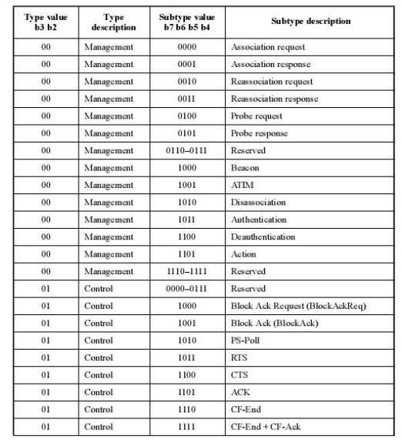
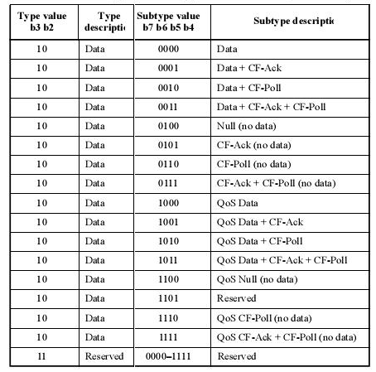
802.11 frame types and subtypes
Type 00 – Management frames
Type 01 – Control frames
Type 10 – Data frames
Wireless, Mobile Networks
6-<number>

Slide 37

802.11: mobility within same subnet
H1 remains in same IP subnet: IP address can remain same
switch: which AP is associated with H1?
  self-learning (Ch. 5): switch will see frame from H1 and “remember” which switch port can be used to reach H1
BBS 1
H1
BBS 2
Wireless, Mobile Networks
6-<number>

Slide 38
802.11: advanced capabilities
Rate adaptation
base station, mobile dynamically change transmission rate (physical layer modulation technique) as mobile moves, SNR varies
10⁻¹
10⁻²
10⁻³
BER
10⁻⁴
10⁻⁵
10⁻⁶
10⁻⁷
10
20
30
40
SNR(dB)
1. SNR decreases, BER increase as node moves away from base station
QAM256 (8 Mbps)
QAM16 (4 Mbps)
2. When BER becomes too high, switch to lower transmission rate but with lower BER
BPSK (1 Mbps)
operating point
Wireless, Mobile Networks
6-<number>

Slide 39
802.11: advanced capabilities
power management
node-to-AP: “I am going to sleep until next beacon frame”
  AP knows not to transmit frames to this node
  node wakes up before next beacon frame
beacon frame: contains list of mobiles with AP-to-mobile frames waiting to be sent
  node will stay awake if AP-to-mobile frames to be sent; otherwise sleep again until next beacon frame
Wireless, Mobile Networks
6-<number>

Slide 40
Chapter 6 summary
Wireless
wireless links:
  capacity, distance
  channel impairments
  CDMA
IEEE 802.11 (“Wi-Fi”)
  CSMA/CA reflects wireless channel characteristics
cellular access
  architecture
  standards (e.g., GSM, 3G, 4G LTE)
Mobility
principles: addressing, routing to mobile users
  home, visited networks
  direct, indirect routing
  care-of-addresses
case studies
  mobile IP
  mobility in GSM
impact on higher-layer protocols
Wireless, Mobile Networks
6-<number>

